Slide 1
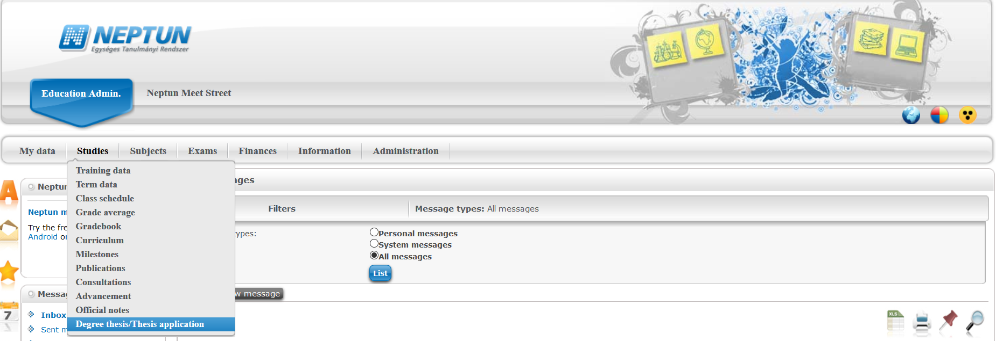
Studies -> Degree thesis/Thesis application

Slide 2
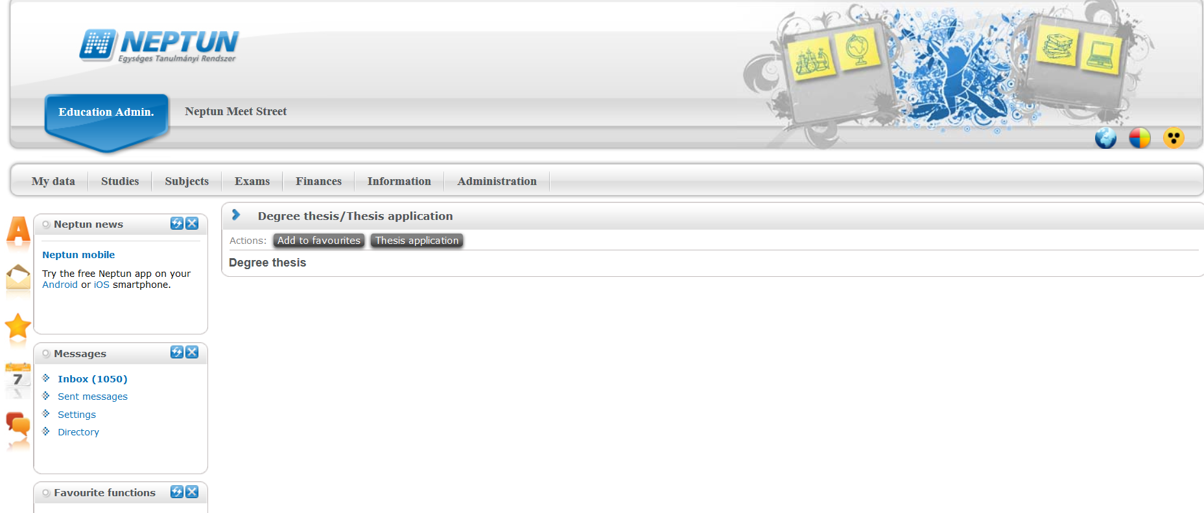
Thesis application

Slide 3
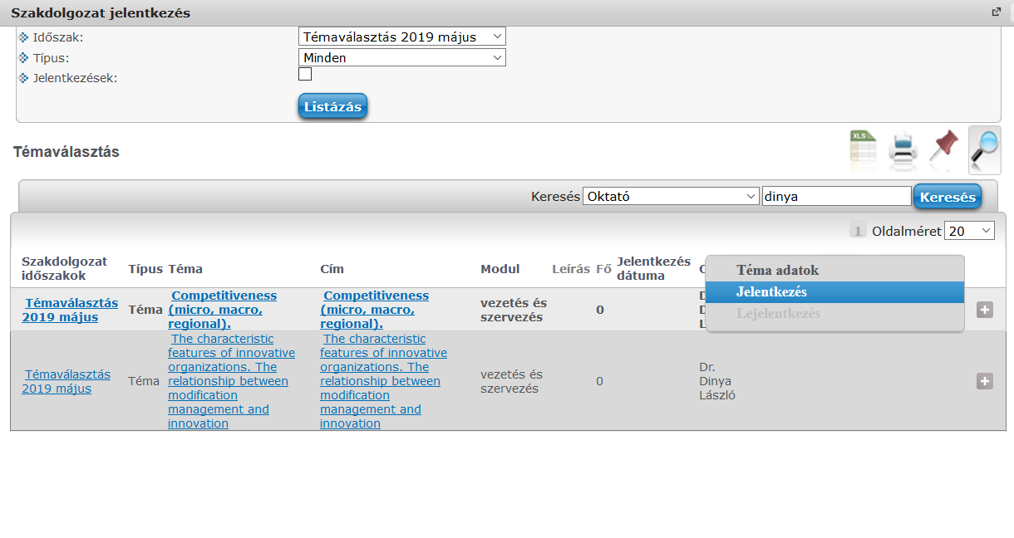
Choose period and set type to topic
Current topics appear.
Choose apply by clicking on + at the end of a topic.
Only topic application shall be submitted!

Slide 4
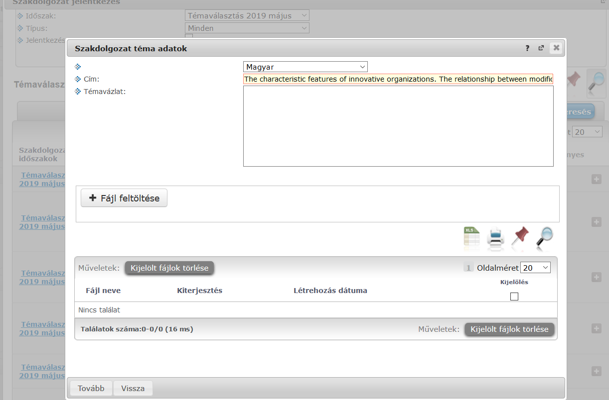
In the pop-up window, you can add the title of your thesis which may not be your final title. A short outline of your thesis shall be uploaded here which was previously accepted by your supervisor. Only PDF files can be uploaded. Click on „continue”.

Slide 5
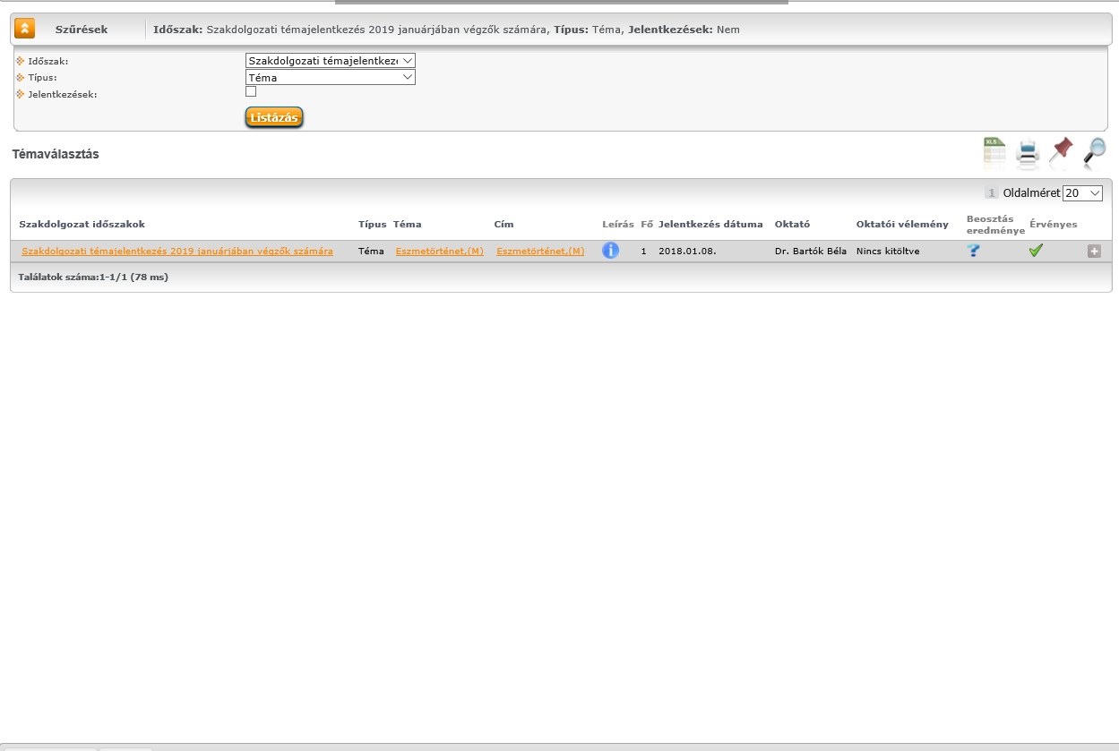
Following the application, you shall wait for the evaluation and the categorization.

Slide 6
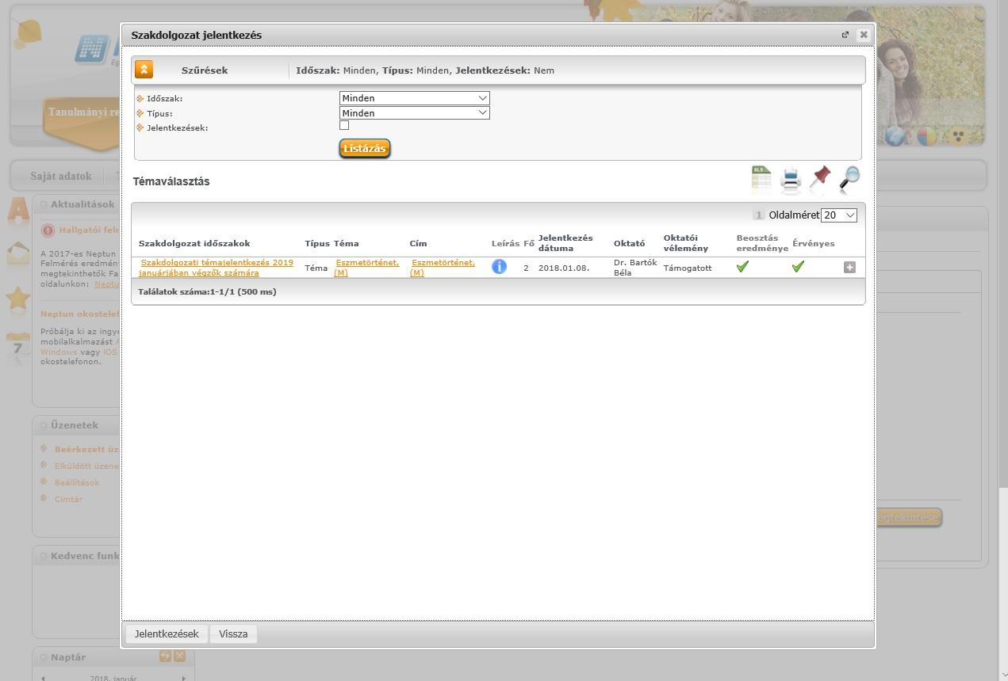
After categorization, you can find your result in the same Neptun section. If there is a green tick in the result column, your thesis has been accepted. In case of a red x, your thesis has been rejected.

Slide 7
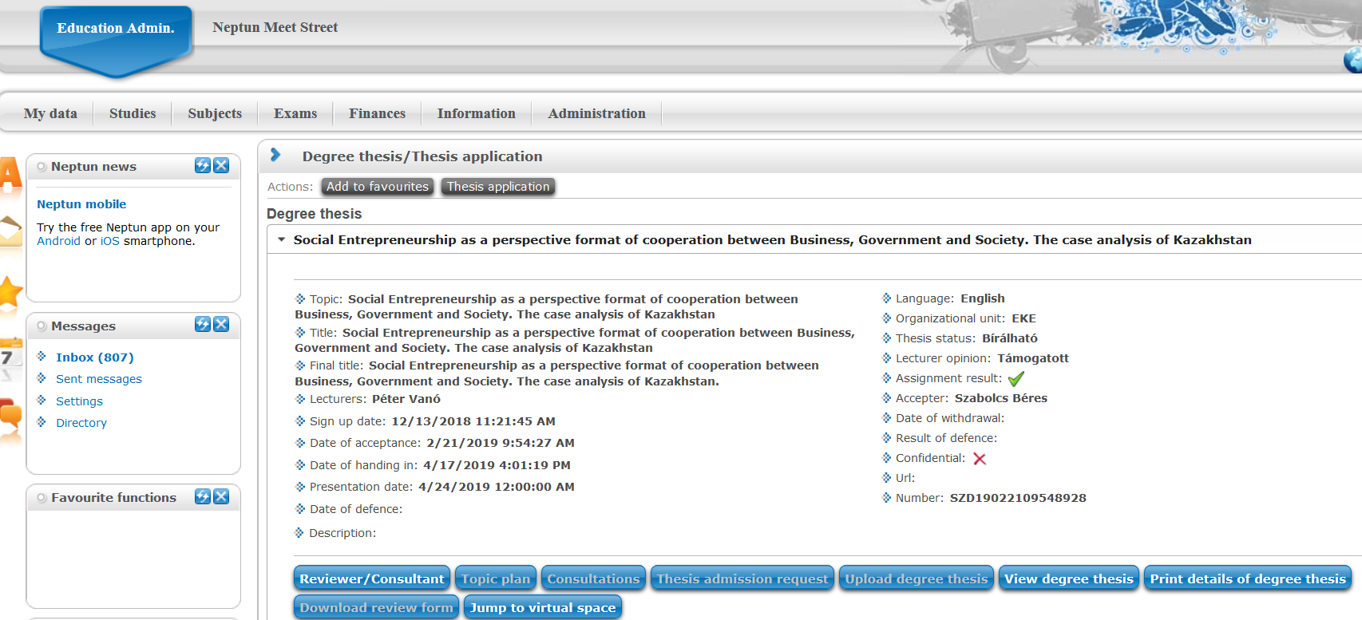
In case of an accepted thesis, your thesis is ready in the relevant section.

